Slide 1
Azure Fundamentals
Building Cloud Native Applications in Azure

Slide 2


Meet Your Instructors
Dustin Ewers
Steve Hirscher
Architect: Retirement
12+ years experience
Speaker / Writer
Architect: Consumer
15+ years experience
5+ years at CUNA

Slide 3
Course Goals
Learn About Azure Services
Learn How to Interact With Azure
Build Applications Using Azure
Notes:
This is going to be a more hands on course.

Slide 4
Azure Basics
Azure Storage
Azure Batch Processing
App Service Plans
Container Architecture
Serverless
Messaging
Security
Cost Management
APIs and Services
Roadmap

Slide 5
Modules
Lecture + Labs
Breaks: During the Lab Time
Pair / Group (if you want)
Ask Questions
Logistics

Slide 6
Azure Basics

Slide 7
Subscriptions
Resource Groups
Tags
How Do I Organize my Stuff?
Notes:
Subscriptions - top level construct, per dept, per company, etc..
Resource Groups - used to organize different services, per application
Tags - can be used organize cross cutting concerns and report on different usages

Slide 8
Retirement-NonProd
Retirement-Prod
RG-App1
Web App
SQL DB
vNet
RG-App2
Func App
Cosmos DB
RG-App1
Web App
SQL DB
vNet
RG-App2
Func App
Cosmos DB
Tag1
Tag1
Tag1
Tag1

Slide 9
How do I use it?

Slide 10
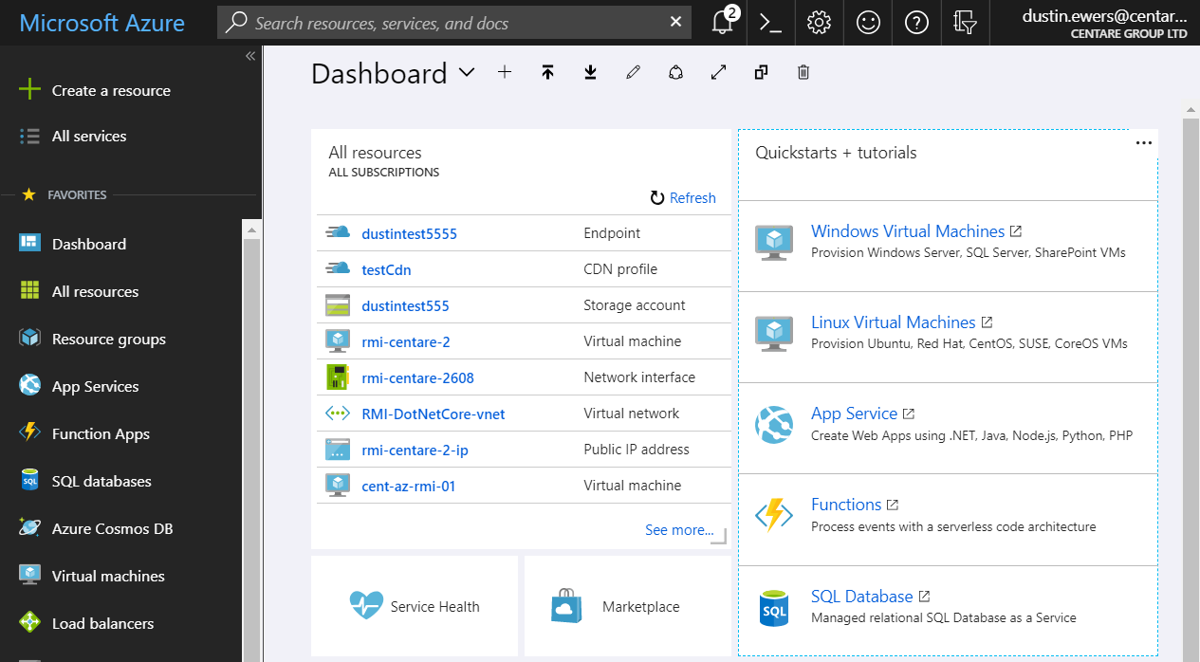
Azure Portal
Notes:
The portal is great for exploring
Not so great for automation
portal.azure.com
<shell out to the portal and take a look around>

Slide 11
Azure CLI
Command Format: az <resource type> <action> <options>
Add --help or -h for assistance
Format output using -o or --output
(valid outputs include table and tsv)
az group list
az group --help
az group list --output table
Notes:
CLI is the new default
Great for automation
Local install
shell.azure.com

Slide 12
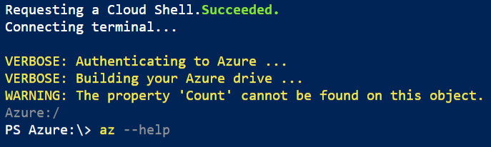
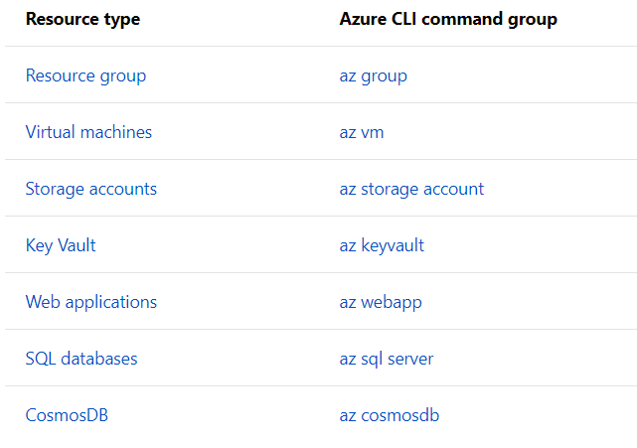
Azure CLI

Slide 13
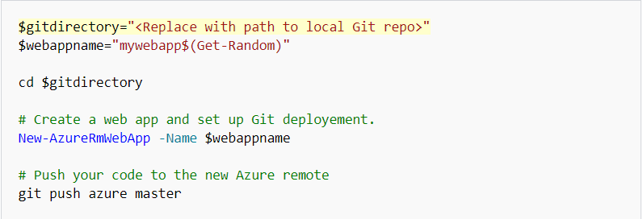
Azure Powershell
Notes:
Certain parts of powershell have been depreciated, use the CLI

Slide 14
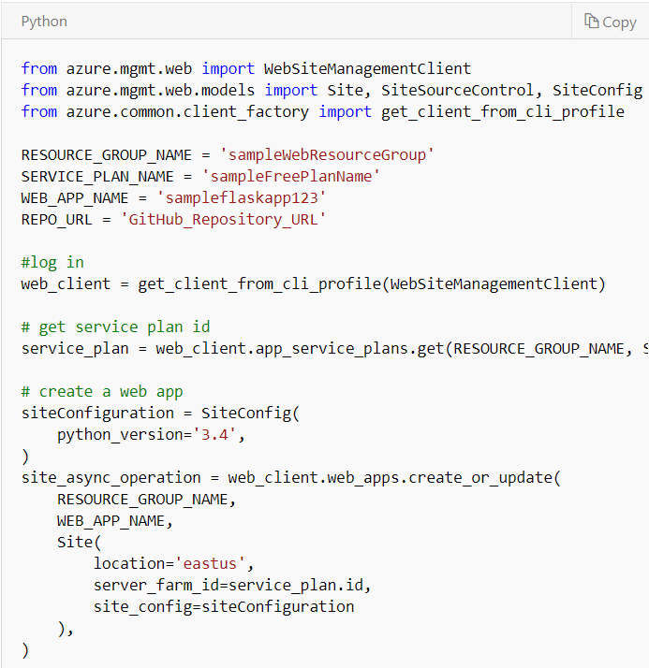
C#, Python, JavaScript, REST, [and others]
Azure SDK
Notes:
These client libraries are built on top of the REST API

Slide 15
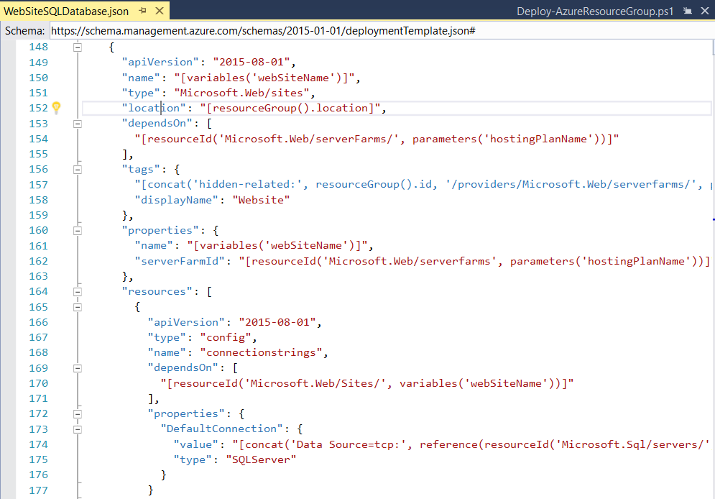
ARM (Azure Resource Manager) Templates

Slide 16
Azure Credits
MSDN
Azure Trials
Pay As You Go

Slide 17
What can I build?

Slide 18
Virtual Infrastructure (IaaS)
VMs
Network Resources
Firewalls
Load Balancers
Virtual Networks
GPU clusters
CDNs (Content Delivery Network)

Slide 19
App Services
Azure Kubernetes Service
Azure Service Fabric
Azure App Service Plans
Azure Functions

Slide 20
Batch Processing
Web Jobs
Azure Batch
Azure Data Factory
SQL data Warehouse

Slide 21
Data Storage
Azure Storage Accounts
Cosmos DB
Azure SQL
REDIS Cache
Azure Key Vault

Slide 22
Messaging
Storage Queues
Service Bus
Event Hub
Event Grid

Slide 23
Apis / Services
Azure Active Directory
Cognitive Services
Azure Bot Services
Application Insights
Mobile App Center
Logic App

Slide 24
Lab: Explore the Portal and Azure CLI
https://github.com/centaretraining/azuretraining

Slide 25
Azure Storage

Slide 26
Blobs
Tables
Files
Queues
Storage Accounts
Notes:
Blobs - Binary large objects. Used for files, images, etc…
Tables - NoSQL Key/Value store
Files - SMB file shares, use blob storage
Queues - simple cloud messaging, use service bus instead
https://docs.microsoft.com/en-us/azure/service-bus-messaging/service-bus-azure-and-service-bus-queues-compared-contrasted

Slide 27
Performance Tiers - Standard, Premium
Access Tiers - Hot, Cool, Archive
Encryption - done by default
Storage Accounts Continued
Notes:
Performance Tiers:
Standard
Premium
Access Tiers:
Hot - frequently accessed
Cool - stored for at least 30 days
Archive - stored for at least 180 days, latency measured in hours

Slide 28
Locally Redundant (LRS): Same Datacenter
Zone Redundant (ZRS): Same Region
Geo-Redundant (GRS) - Different Regions
Storage Account Replication
Notes:
Locally Redundant (LRS): Same Datacenter | 11 9’s
Zone Redundant (ZRS): Same Region | 12 9’s
Geo-Redundant (GRS) - Different Regions | 16 9’s
https://docs.microsoft.com/en-us/azure/storage/common/storage-redundancy

Slide 29
Azure SQL Database
SQL Server on VMs
Azure MySQL
Azure Postgres
Azure MariaDB
Azure Databases

Slide 30
Managed SQL Server DB
Feels like On Prem SQL Server
Pricing Tiers - DTUs, vCores
Encrypted by Default (TDE)
Firewalled by Default
Azure SQL Database
Notes:
Managed SQL Server DB
Feels like On Prem SQL Server | Dev XP is just like a normal SQL Server
Pricing Tiers - DTUs, vCores | DTUs are increments of compute and memory. You can either get a set amount or an elastic pool of DTUs
vCores are more granular
Encrypted by default using transparent data encryption.
Firewall - comes with it’s own firewall that you can configure to limit incoming connections
https://docs.microsoft.com/en-us/azure/sql-database/transparent-data-encryption-azure-sql?view=sql-server-2017
https://docs.microsoft.com/en-us/azure/sql-database/sql-database-purchase-models

Slide 31
Globally Distributed
NoSql DB
Multiple APIs (Mongo, Cassandra, Gremlin)
Crazy Fast
Cosmos DB

Slide 32
Managed Redis Instance
In-memory Datastore
Built in Firewall
Tiers - Basic, Standard, Premium
Azure Cache for Redis
Notes:
Managed Redis Instance
In-memory Datastore
Tiers -
Basic - For development and experiments
Standard - for light development
Premium - includes more throughput, but more importantly, more security
https://docs.microsoft.com/en-us/azure/azure-cache-for-redis/cache-premium-tier-intro

Slide 33
Service | Use it for...
Storage Accounts | File Storage (Blobs)
Azure SQL | Relational Databases
Cosmos DB | NoSQL, Highly Scalable
REDIS | Caching

Slide 34
Lab: Let’s Make a SQL Database

Slide 35
App Service Plans

Slide 36
App hosting
Based on a group of VMs
Autoscale
Auto backups
App Service Plans

Slide 37
Supports: .NET, .NET Core, Node.js, etc…
Web Apps
API Apps
Function Apps
Webjobs
Tiers: Basic, Standard, Premium, Isolated
App Service Plans
Notes:
Lots of supported languages: PHP, Ruby, Java, Python, .NET, .NET Core, Powershell (as a batch process)
Tiers: Basic, Standard, Premium, Isolated
Higher tiers = better machines and more features
Basic = dev / test
Standard = prod
Premium = Standard plus more backups / features
Isolated = ASE, super expensive

Slide 38
Built in Auth Available (Including AD)
Automatic Server Patches
Azure Key Vault Integration
IP Filtering
vNET Compatibility
Security

Slide 39
Lab: Let’s Deploy an Web Application on App Services

Slide 40
Containers on Azure
Docker, Kubernetes, and AKS

Slide 41
VMs vs. Containers
Virtual Machines
Containers
Application
Application
Bins/Libraries
Bins/Libraries
Application
Application
Guest OS
Guest OS
Bins/Libraries
Bins/Libraries
Hypervisor
Container Engine
Host OS
Host OS
Server
Server
Notes:
Containers don’t have a full OS for each container, which saves space

Slide 42
Layered Containers
Container Image
Application Artifacts (your app)
Common Hardening / Configuration
Reusable
Application Platform (ex - .NET Core)
Base Image (ex - Alpine Linux)

Slide 43
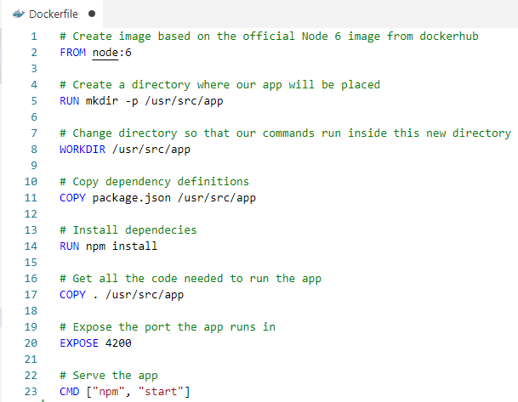

Slide 44
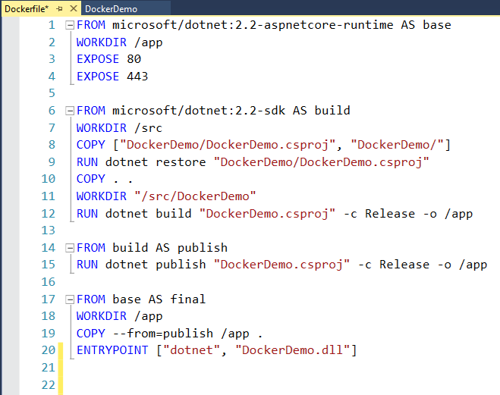
Image: Build the Application
Image: Run the Application
Notes:
Default .NET Image
Multi Stage Build Pattern
Layering Images to reduce the size and attack surface of the final image

Slide 45
How to do we run an image?
Notes:
Just straight up Docker or…

Slide 46
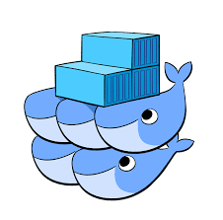
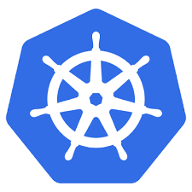

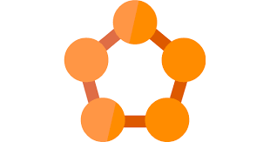
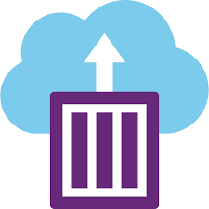
Orchestration
Docker Swarm
Kubernetes
Mesos
Service Fabric
Azure Container Instances
Notes:
Orchestration is the software that manages your containers and makes them into a whole application.
There’s tons of different ways to run Docker containers.
Every cloud provider has their own orchestration offering

Slide 47
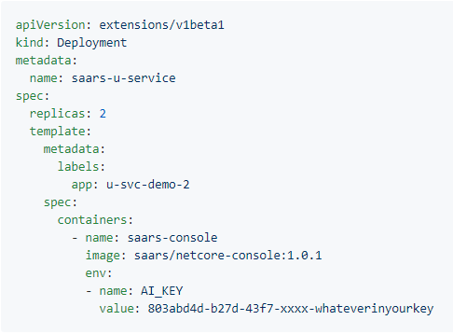
Kubernetes
Created by Google
Datacenter in a box
Organization
Pods
Deployments
Services
Notes:
File Source:
https://github.com/Microsoft/ApplicationInsights-Kubernetes/wiki/Getting-Started-for-.NET-Core-Applications
Pods - smallest deployable unit | Generally one container (and maybe a sidecar to go with it)
Deployments - groups of Pods | manages things like scalability
Services - Networking between groups of Pods
https://kubernetes.io/docs/concepts/workloads/pods/pod-overview/
https://kubernetes.io/docs/concepts/workloads/controllers/deployment/
https://kubernetes.io/docs/concepts/services-networking/service/

Slide 48
Applications (Obviously)
API Gateways
Databases
Logging and Monitoring Frameworks
etc...
What can you run using Docker / Kubernetes?
Notes:
There’s probably a docker container for everything you want to do
The only caviat is you don’t want to store state in Kubernetes
----
Docker / Containers are really good for experimentation. You can easily fire up stuff and play with it without having to install a bunch of junk on your machine.

Slide 49
Cloud Native Interactive Landscape
https://landscape.cncf.io/
Notes:
Kubernetes is at the center of a whole cloud native ecosystem.
It has all sorts of stuff...

Slide 50
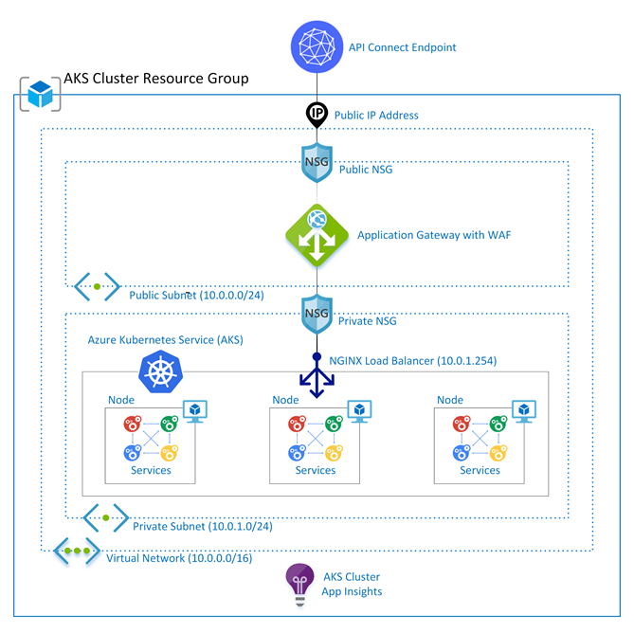
Titan Atlas
Notes:
CUNA Team AKS offering that deploys an Azure Kubernetes Service instance with a bunch of security around it…
Implements nearly 200 controls for you

Slide 51
Serverless On Azure

Slide 52
“The Cloud” is just someone else’s computer.
… and sometimes you don’t have to see that computer

Slide 53
Azure Functions
Logic Apps
Azure Storage
Cosmos DB
Azure Active Directory
Service Bus
Serverless on Azure
Notes:
https://azure.microsoft.com/en-us/overview/serverless-computing/#explore-azure-serverless-apps

Slide 54
Serverless APIs
Can be stateless or stateful (Durable Functions)
Azure Functions

Slide 55
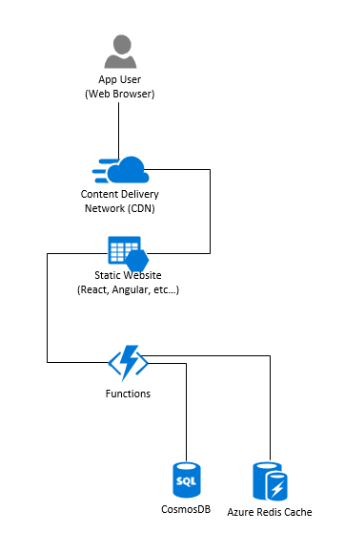
Serverless Web Application

Slide 56
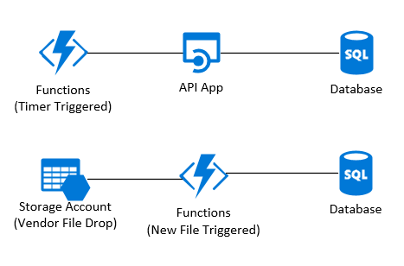
Serverless Batch Processes

Slide 57
Lab: Let’s Build a Serverless App

Slide 58
Azure Messaging

Slide 59
Storage Queues
Service Bus
Event Hub
Event Grid
Message Brokers

Slide 60
Large storage limit (>80GB per queue)
Messages can be updated in the queue
Inexpensive
No long polling
Small message size limit (64KB)
No pub/sub or advanced features
Storage Queues
Notes:
Note that you could extend the message size by including extra data in BLOB storage.
You could do this with other queues too, but you already have a storage account in this case

Slide 61
Larger message size limit (1MB in Premium tier)
Supports topics and subscriptions
AMQP or long polling over HTTP
VNet support
Advanced features (sessions, dead-lettering, scheduled delivery, FIFO, dupe detection...)
More complicated to configure/manage
No push delivery
Generally slower and more expensive
Service Bus

Slide 62
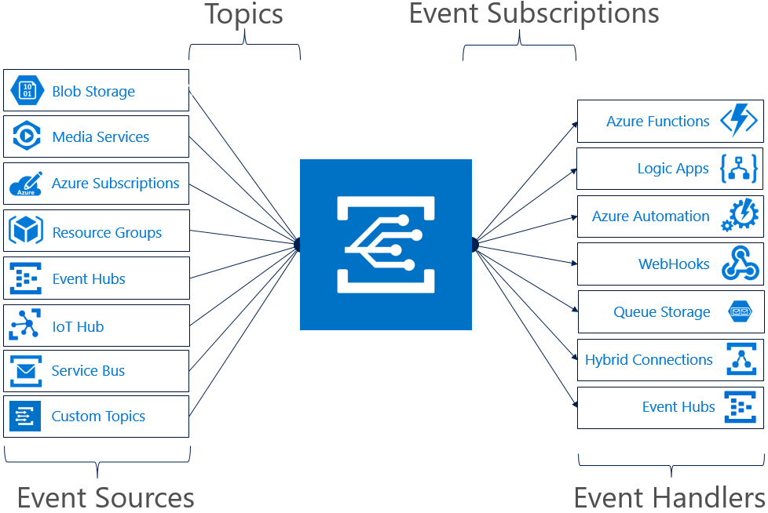
Event Grid

Slide 63
Massive throughput (at least 5K messages per second, capable of 10 million per second per region)
Built in events from many Azure services
Integrations with several different Azure services as subscribers
Completely unmanaged
HTTP push based delivery
Inexpensive
Very small message size limit (64KB)
Multi-tenant system
Push based - querystring based “security”
Required message format
Event Grid
Notes:
Has a pre-defined message format you ahve to follow
but - supports an open event message standard (not on by default)

Slide 64

Event Hub

Slide 65
Extremely high throughput (1MB/sec ingress, 2x egress per throughput unit)
Integrations with Storage Accounts (Event Hub Capture) and Stream Analytics
Kafka client support
Consumer must manage the offset
Competing consumer model doesn’t really work
Event Hub
Notes:
Has a pre-defined message format you ahve to follow
but - supports an open event message standard (not on by default)

Slide 66
Which to pick?
Storage Queues
Apps that need basic message queueing and already have an established storage account.
Apps that just need to queue up file processing
Event Hub
“Big Data in Motion”
Event streaming - Telemetry, IOT
Event Grid
Responding to and processing Azure events
Web hook systems
When the processing is serverless (Azure Functions)
Service Bus
Discrete business events

Slide 67
Lab: Messaging with Azure Service Bus

Slide 68
Azure Networking

Slide 69
Virtual Networks (VNets)
Subnets
IP Addresses
NICs
Network Appliances
Components
Notes:
Not just for IAAS

Slide 70
Virtual Networks
A private address space (10.0.0.0/24)
Scoped to a single region
Subnets
Segments the network
IP Addresses
Public or private
Public IPs can be dynamic or static
VNets & Subnets
Notes:
Know your CIDR notation (just use a subnet calculator)

Slide 71
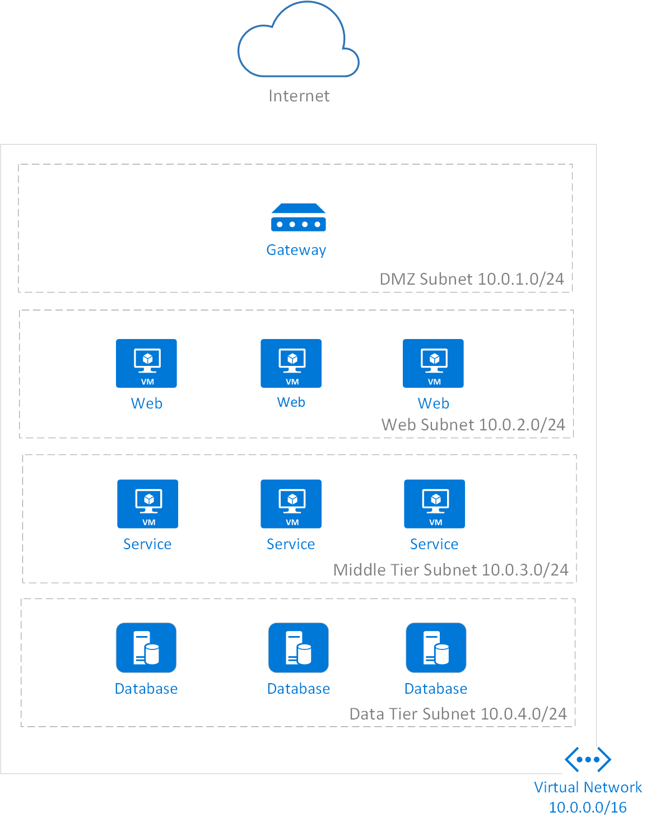
Subnet Segmentation
Notes:
Not a real setup, wouldn’t need an entire /24 (256-5 addrs) for DMZ
Also, fairly basic
Didn’t put in details, may have load balances/firewalls between each

Slide 72
VNet Peering
Route traffic between VNets
VPN Gateways
Route on-prem network over the internet
ExpressRoute
Route on-prem network over dedicated line
Service Endpoints
Route to cloud service within Azure network
App Service VNet Integration
Route from App Service to VNet within Azure network
Routing Traffic

Slide 73
Azure Firewall
Azure Load Balancer
App Gateway
API Management
Network Virtual Appliances (NVAs)
Network Appliances

Slide 74
Typically used for securing traffic between networks
Stateful firewall
IP, Port, Protocol based filtering
Domain name filtering
NAT support
Microsoft Threat Intelligence
Azure Firewall

Slide 75
More IAAS focused load balancing generic traffic IP, Port, Protocol based filtering
Domain name filtering
NAT support
Microsoft Threat Intelligence between VMs
Application agnostic load balancing
Not protocol specific (supports UDP)
Azure Load Balancer
Notes:
You could do UDP load balancing with this
There are better tools for security and load balancing ingress web traffic

Slide 76
HTTP load balancer, reverse proxy, and layer 7 gateway
Web app firewall (OWASP)
Load balancer
SSL termination
URL based routing
Request rewriting
Application Gateway

Slide 77
HTTP service gateway meant for publishing APIs to consumers
Service catalog
Subscription management
Mock responses
Request/Response rewriting
API versioning
API Management

Slide 78
Lab: Network Security

Slide 79
Cloud Security

Slide 80
The shared responsibility model
Defense in depth
Azure security
Networking
Authentication and access management
Data security and encryption
Secure an example application
Roadmap

Slide 81
How Secure is the Cloud?

Slide 82
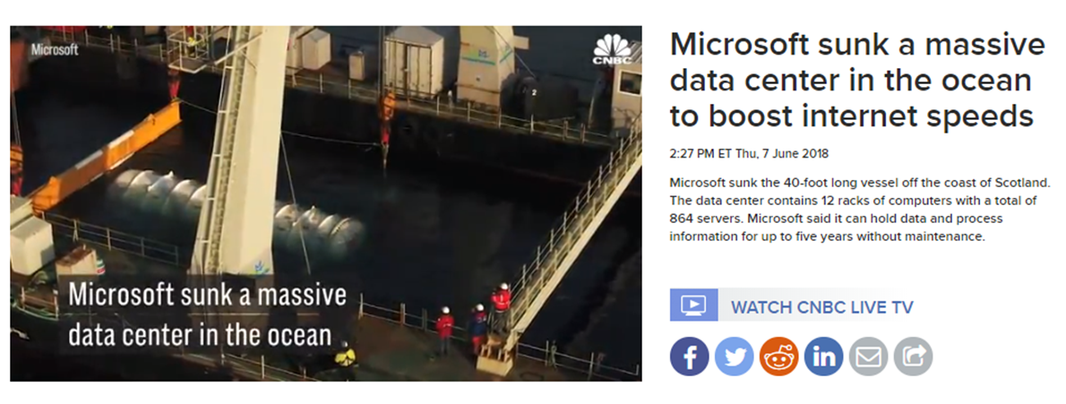
Very Secure!
Notes:
Cloud providers have way more resources than you could possibly ever have
Is your data center’s physical security better than Microsoft’s?

Slide 83
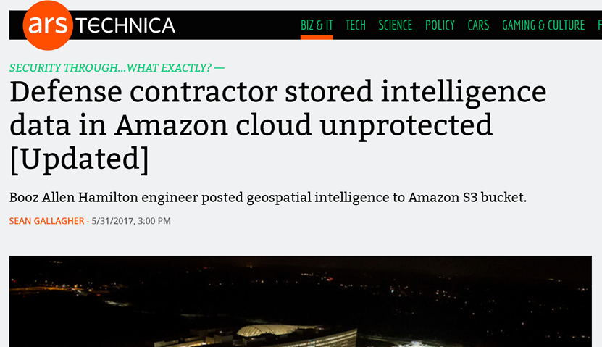
… for the things they are responsible for

Slide 84
Through 2022, at least 95% of cloud security failures will be the customer's fault.
- Gartner

Slide 85
The Shared Responsibility Model

Slide 86
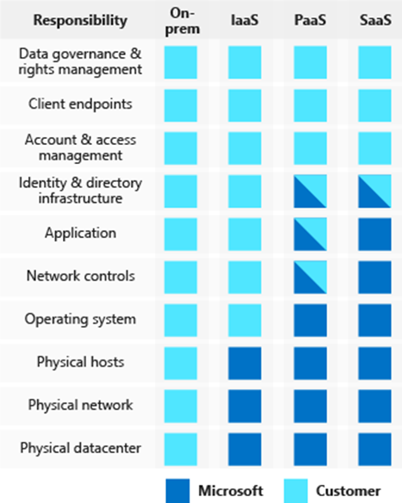
The Shared Responsibility Model
Azure is responsible for the security
OF the cloud
You are responsible for security IN
the cloud
Notes:
On premise you’re in charge of everything
-Physical access to datacenter as mentioned
-What about physical
-Are your operations people checking to make sure the hardware you are buying is secure? Are they securing the supply chain?
-AWS found out that hardware from china had chips embedded in the

Slide 87
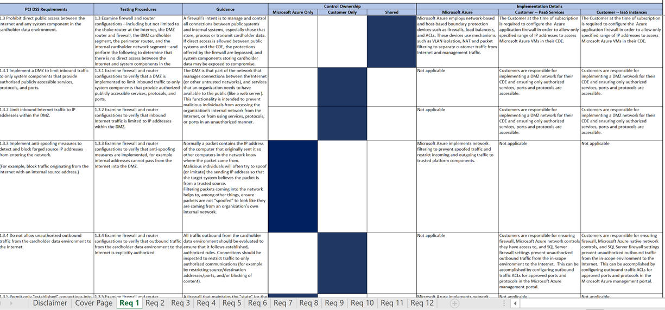
Azure Responsibility Matrix
Notes:
In your case this also includes other departments in CUNA
Operations, sec ops, infrastructure, etc have part of this responsibility
For example - If you use the Titan contaienr solution they have taken responsibility for the security of the AKS configuration and the base container images

Slide 88
Defense in Depth

Slide 89
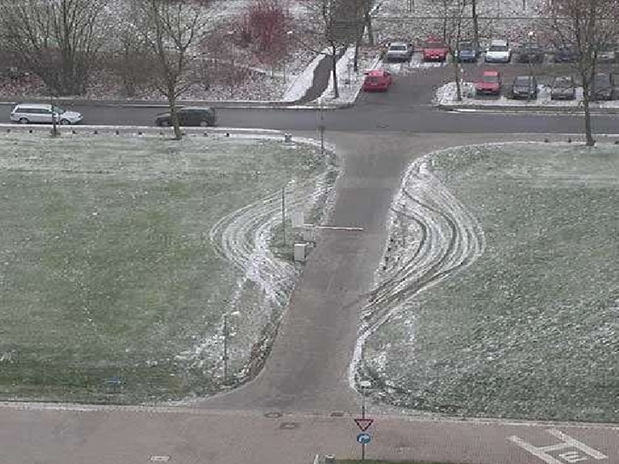
Defense in Depth
Notes:
Azure services are locked down by default
Not extremely secured, but not wide open - a storage account won’t default to public access

Slide 90
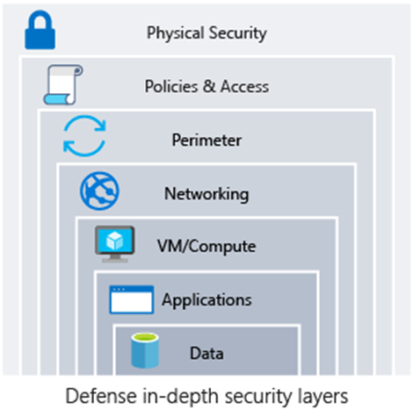
Defense in Depth
Protect every layer so that if one layer is breached, a subsequent layer is already secured to slow the attacker’s advance
Notes:
What if a hacker gets a password?
What if they breach a firewall?
What if they get a virus onto a machine in the network?

Slide 91
The security perimeter has traditionally been the network
Secure inbound ports on the firewall
Monitor all traffic from the internet
In the public cloud authentication may be your perimeter
Security Perimeters

Slide 92
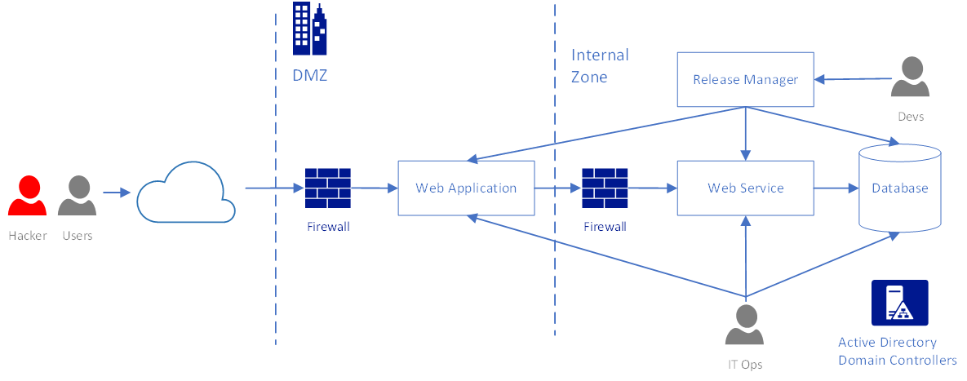
Security Perimeter - On Premise
Notes:
Once you get into those internal subnets you’re isolated
Now you shouldn’t think this way - but you may relax some our your requirements when you get to internet subnets

Slide 93
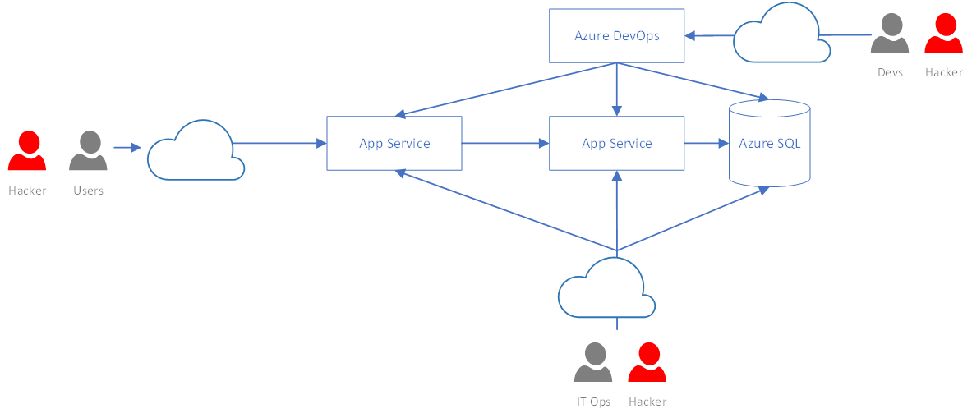
Security Perimeter - Public Cloud
Notes:
In a public cloud scenario all services are potentially accessible from the internet
Can’t do normal security practices like filtering by IP address as all resources, including IPs are ephemeral
- There are solutions to this in some cases, but can’t assume it

Slide 94
Azure Network Security

Slide 95
Most straightforward way to secure resources: Put them in a VNet
Allows for traditional network design (routing, firewalls, subnetting, etc)
Many PAAS services support VNets
App Service Environments
Not available for some services or costs extra
Network Security
Notes:
This is your traditional network security - add firewalls and port rules

Slide 96
Like a simple firewall
Allows or denies traffic between VNet resources
Attached to either subnet or NIC
Define the source, destination, and type of traffic
Defaults to allowing all traffic within the VNet
Network Security Groups

Slide 97
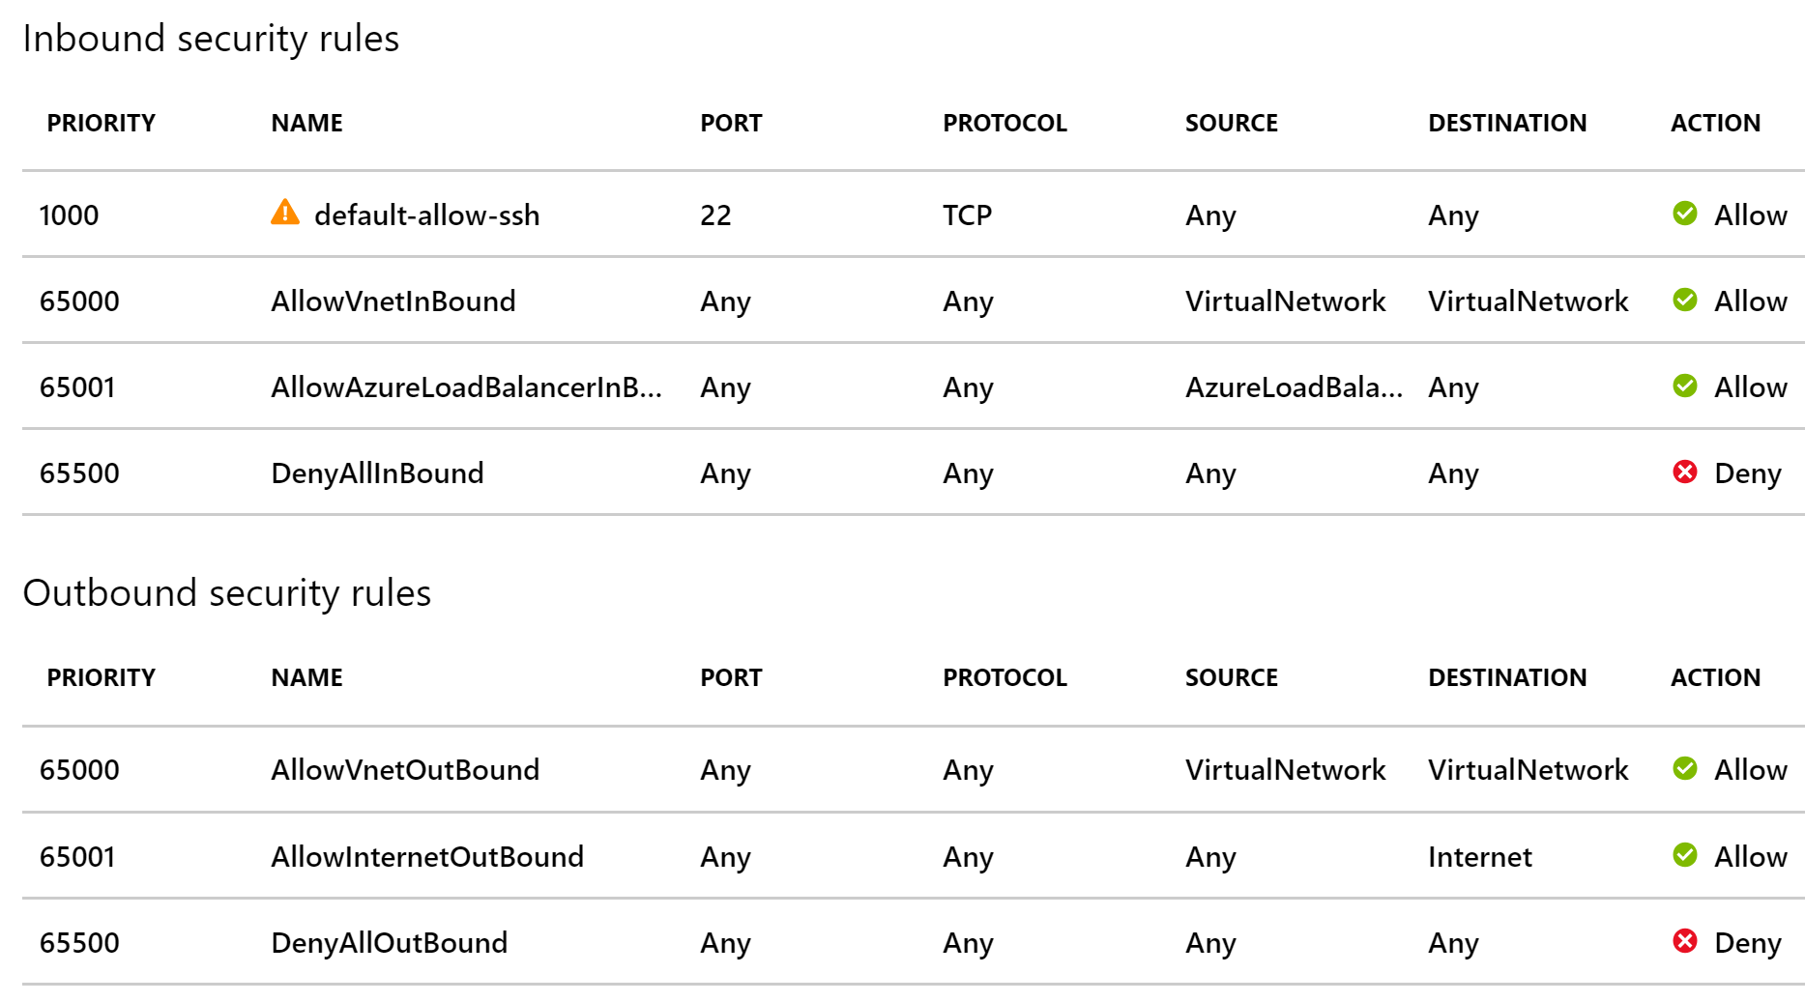
Network Security Groups

Slide 98
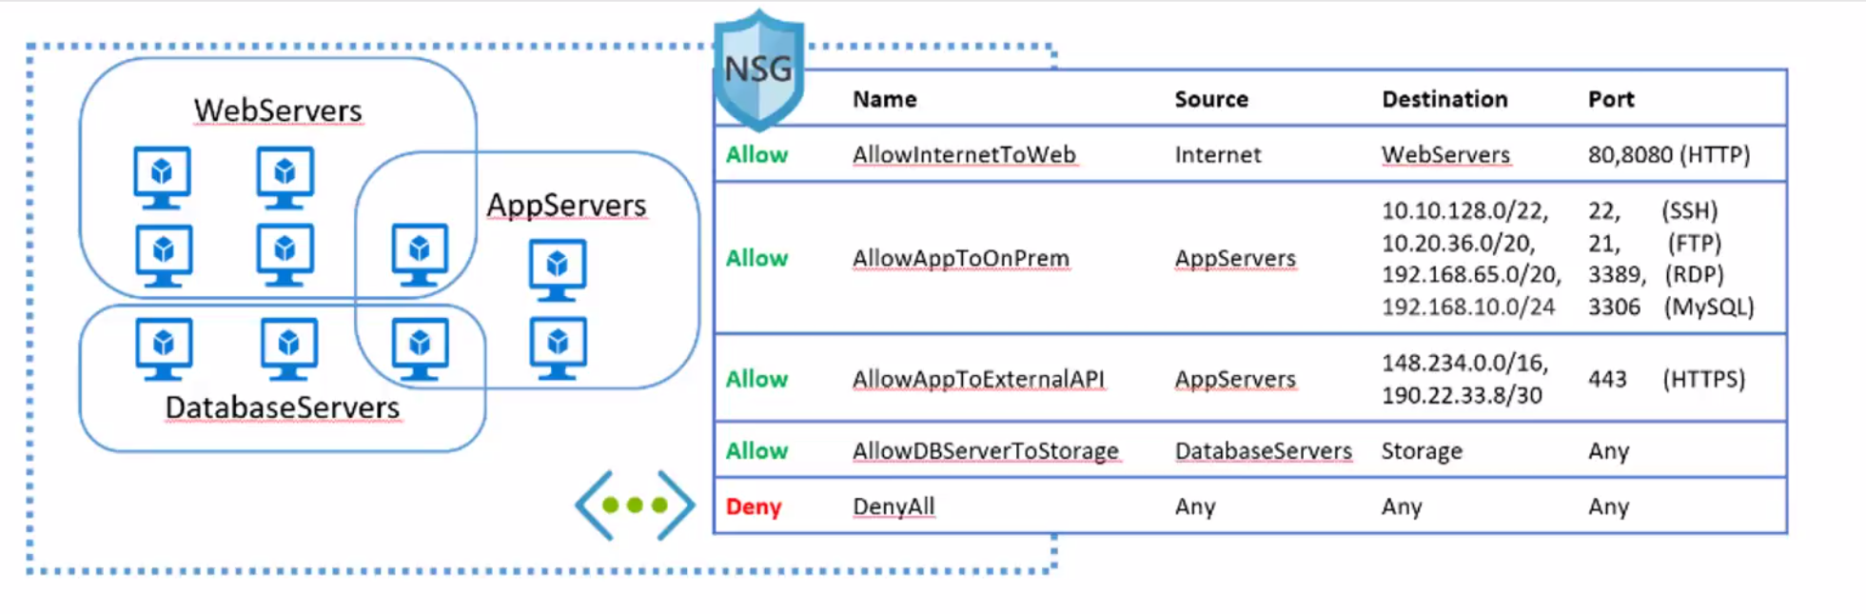
Sources and destinations:
IP addresses
Application Security Groups
Service Tags
Network Security Groups

Slide 99
Route traffic back through your internal network
Common for egress traffic
Use standard methods for filter ingress traffic to allowed services (e.g. web traffic)
Deny all outbound internet traffic
Route internet traffic (e.g. Windows updates) back through internal network.
Backhauling

Slide 100
VNet to PAAS
Service Endpoints
IP restrictions
PAAS to VNet
App Service VNet integration
PAAS to PAAS
Route through VNet
Otherwise you must secure with authentication
Most services will at least let you lock down a service to traffic from Azure services
PAAS Network Security
Notes:
Don’t discount the ability to lock down to Azure services
MS monitors their network very closely and can shut down anything that is misbehaving
Won’t stop targeted attacks, but deters against outside scanning from botnets

Slide 101
Lab: Network Security

Slide 102
Azure Identity and Access

Slide 103
Azure Active Directory
Role Based Access Control (RBAC)
Managed Service Identities
Access keys and shared access signatures
Concepts and Services

Slide 104
Azure Active Directory is NOT the same as Active Directory
Not a replacement for on premise AD
Based on internet authentication protocols
(OAuth 2.0 / OpenID Connect)
AD can synchronize users, groups, and passwords (hashes) to Azure AD
An Azure AD instance is a tenant
Azure Active Directory

Slide 105
Role Based Access Control secures access to Azure resources by assigning Azure Active Directory principals to a Role at a Scope
Example Built-in Roles: Owner, Contributor, Reader
Principals: Users, Groups, and Service Principals
Scopes: Management Group, Subscription, Resource Group, or Resource
RBAC

Slide 106
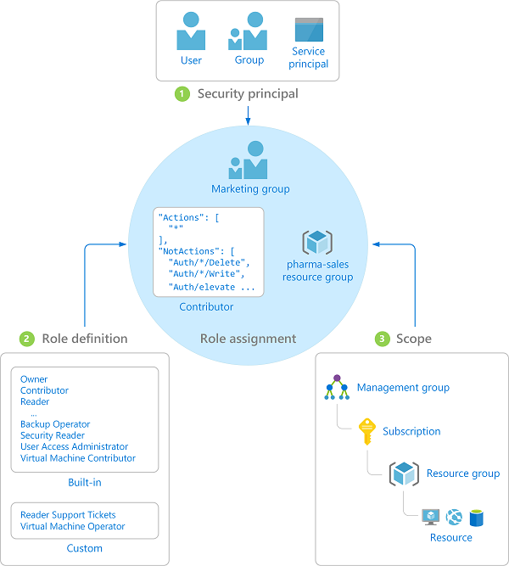
RBAC

Slide 107
RBAC manages the Management Plane
Resources may have their own Data/Service Plane
Management Plane:
The Azure Resource Manager resource
Data Plane:
The data/application itself
Example: Securing access to add a disk to a VM vs logging into the VM
RBAC

Slide 108
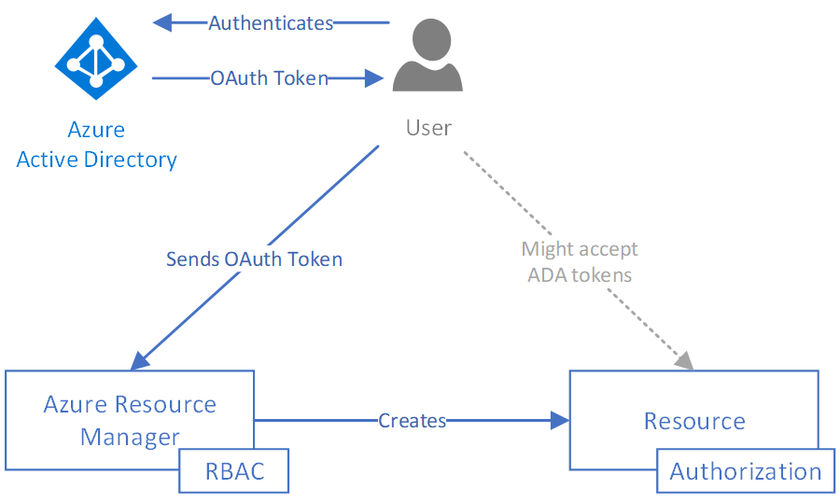
Azure AD, RBAC, and Resource Manager
Notes:
Secures access to _managing the Azure resource_
Does not necessarily secure access to the application/data itself
Microsoft is slowly implementing RBAC for some resources
Other resources might support AD authentication

Slide 109
Managed Service Identities (MSIs) are service principals fully managed by Azure
Tied to a specific application
No storing passwords
Required for some services like Key Vault
Preview support for assigning MSI to a user managed account
Currently only system assigned – i.e. Azure creates the account for you, you can’t use an existing one
Managed Service Identities

Slide 110
Lab: Managed Service Identities

Slide 111
Access Keys and Shared Access Signatures

Slide 112
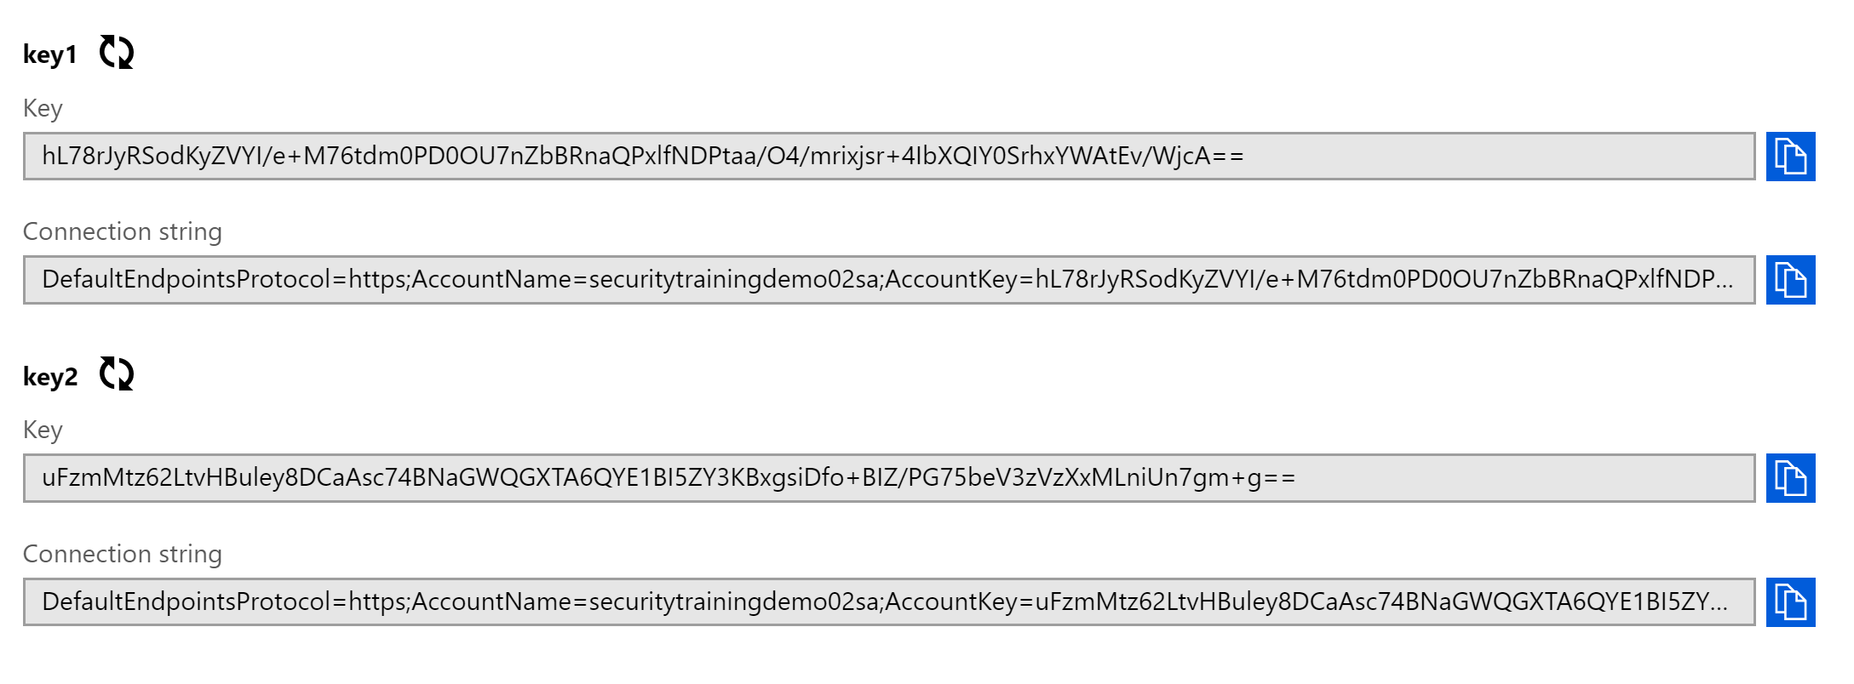
Access Keys are like the “root” credentials for you resource
Used by Azure Storage, Service Bus, Event Grid, Azure Search…
Access Keys

Slide 113
You should rotate your keys frequently
Most services support 2 active keys for rotation purposes
This process should be automated, your apps should be written assuming that keys will change
Instead of storing access keys with your application, consider granting a MSI access to read the keys
Cache the key in your app for slightly less time than the rotation period
Use least privilege – only give access to read the key
Access Keys

Slide 114
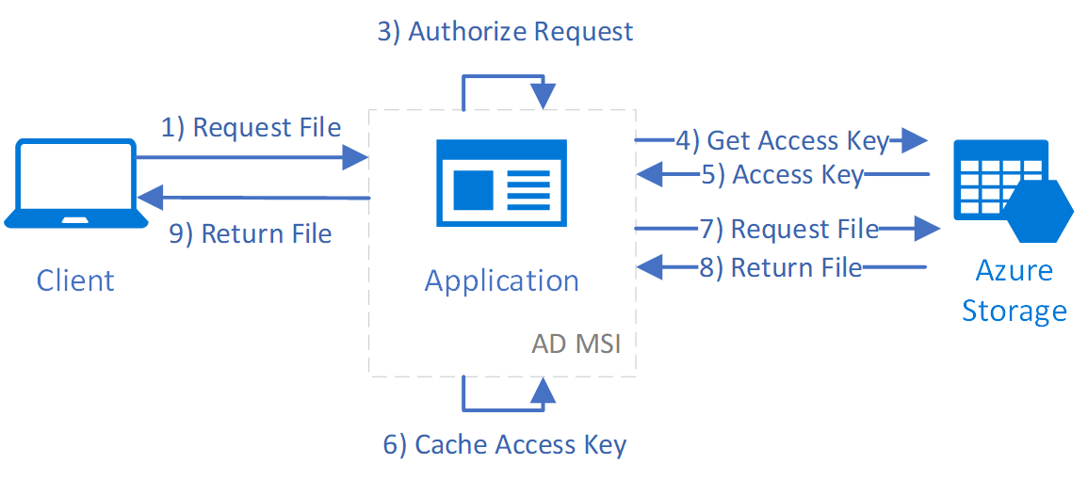
Access Key Flow

Slide 115
Shared Access Signatures (SAS) are tokens that delegate access to specific resources
Extremely granular:
Individual BLOB/table/queue/topic/
Specific operation (Read or Write)
Time based
Limit to specific Ips
Require HTTPS
Shared Access Signatures

Slide 116
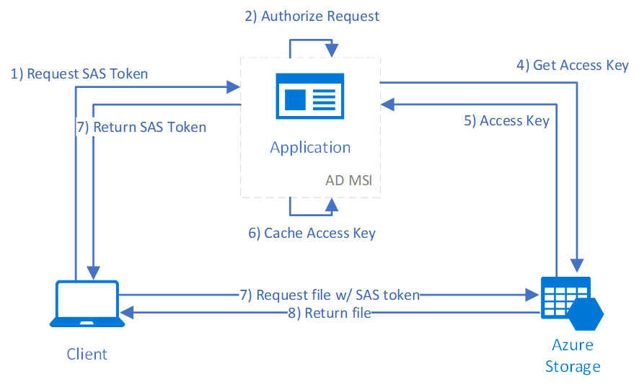
Shared Access Signature Flow

Slide 117
Azure Storage has the most complex SAS model
Access Policies:
Can be used to generate SAS tokens that can be revoked
SAS tokens can be generated at the account and container level too, but this will mostly be replaced by RBAC security soon.
Storage Accounts

Slide 118
Lab: Storage Shared Access Signatures

Slide 119
Azure Data Security

Slide 120
Data in motion
Secret management with Key Vault
Encryption at rest
File encryption
Azure SQL security
Overview

Slide 121
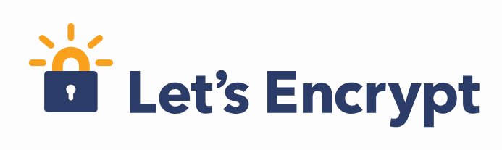
Always encrypt data in motion. Period.
Many services support HTTP and HTTPS
Always use HTTPS
Explicitly turn off HTTP
Data In Motion
Notes:
Remember the architecture course?
You’re not Google, you don’t have so much traffic that SSL termination is necessary

Slide 122
Secure storage for:
Secrets
Encryption keys
Certificates
Secure encryption routines
Integration with numerous Azure services:
Resource manager deployments
Azure DevOps
Storage accounts
Azure SQL (Always Encrypted)
Key Vault

Slide 123
Encryption at rest supported by almost all stateful services
https://docs.microsoft.com/en-us/azure/security/azure-security-encryption-atrest
VMs support hard drive encryption
Storage encryption
Storage Service Encryption (SSE) enabled by default
Client side encryption – Use key vault’s data key service to encrypt before sending to the cloud
Data Encryption

Slide 124
Transparent data encryption (TDE)
Auditing
Always Encrypted
Data masking
SQL Encryption

Slide 125
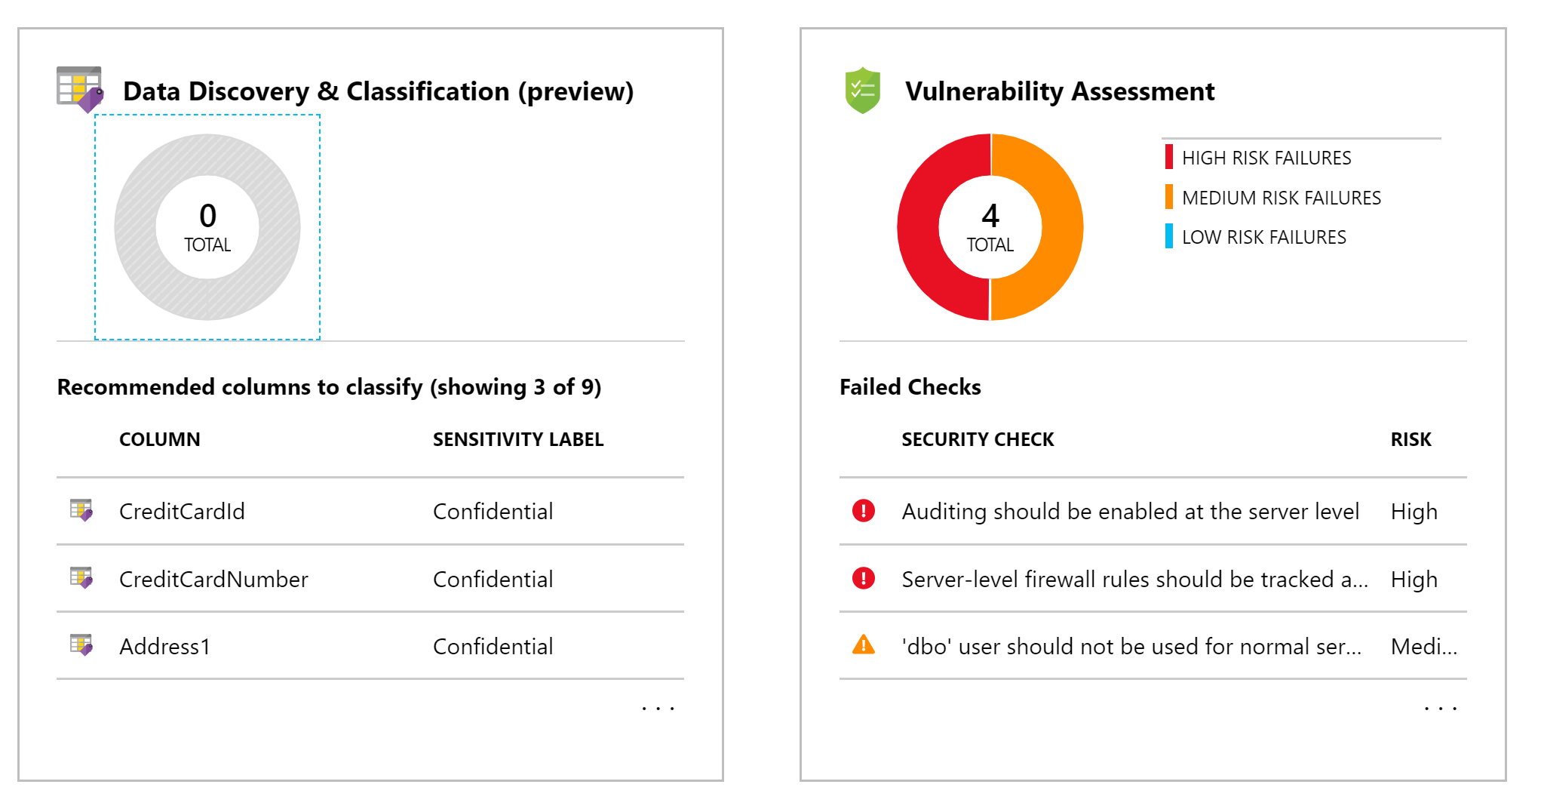
Advanced Threat Protection
Discovers and classifies sensitive data, manages vulnerabilities, and detecting anomalous activities
Includes compliance specific recommendations (e.g. GDPR)
SQL Advanced Threat Detection

Slide 126
Lab: SQL Data Security

Slide 127
Cloud Economics

Slide 128
What we’ll be covering:
Cloud vs on premise cost comparison
Estimating costs
Monitoring costs with
Billing dashboards
Azure Cost Management
Azure advisor
Designing cloud solutions for cost savings
Real application example
Cost risks in the cloud
Overview

Slide 129
Is the cloud cheaper than on premise?
Notes:
How many of you have some workloads in the cloud?
Were you surprised by the cost?

Slide 130
Let’s do the math
On Premise:
https://www.fusionalliance.com/wp-content/uploads/2016/07/faCloudOnPremisesFoundations.pdf
Dell R320 - $2000 or $55/month for 56 months
Power consumption: $29/month
Rack space: $10/month/sq foot = $80/month
~$164 per month
Cloud:
Azure IaaS D2 SSD instance
$208 per month

Slide 131
Let’s do the math
What about a rack of 42 servers?
On premise:
$27 (rack) +42 * $55 (capital) +42 * $29 (power) + $80 (space) _______________ $3,635 per month
Cloud
42 * $200 _______________ $8,400 per month!

Slide 132
But wait, there’s more!
Building and network security
Setup and configuration
Tax implications
Time to implement
Maintenance issues and fees
Management software
Load balancing
Redundant enterprise storage
SAN costs generally $5-$15 per GB
Cloud costs about $.10 per GB
Geo-redundancy

Slide 133
Cloud cost savings
The big advantages of the cloud come from:
Speed to market
Flexibility
Fine-Grained resource management
Other takeaways:
Replicating your data center in the cloud with IaaS is not the most cost effective option
The cloud comes with advanced monitoring and management tools, often for free

Slide 134
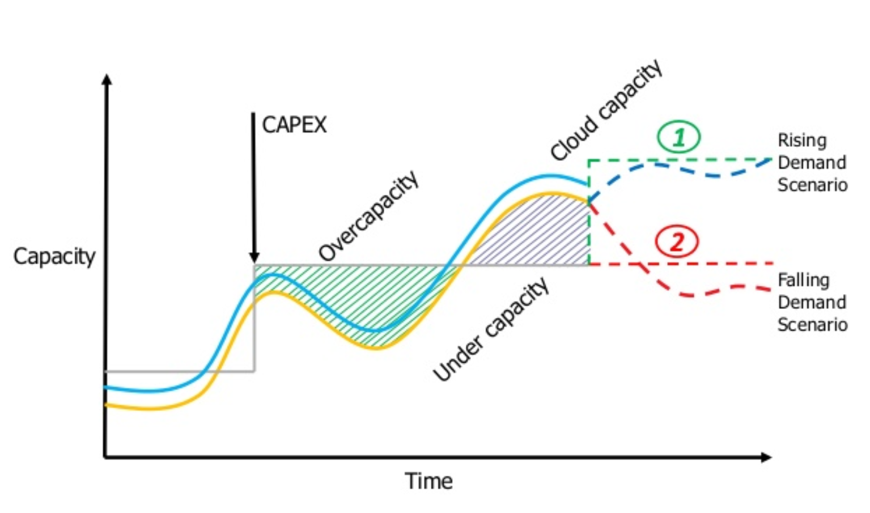

Slide 135
The good news:
A system’s design can have immediate significant effect on its operational cost

Slide 136
The bad news:

Slide 137
The bad news:
A system’s design can have immediate significant effect on its operational cost

Slide 138
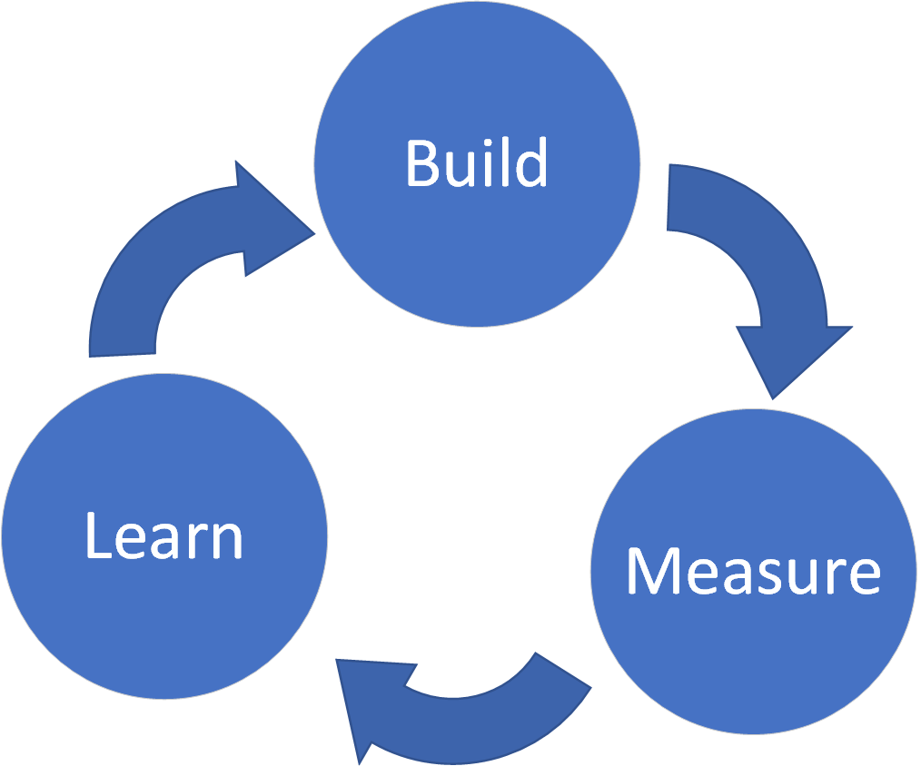
How do you design for cost savings?
Calculate estimate
Gather baseline metrics
Measure and iterate
Repeat

Slide 139
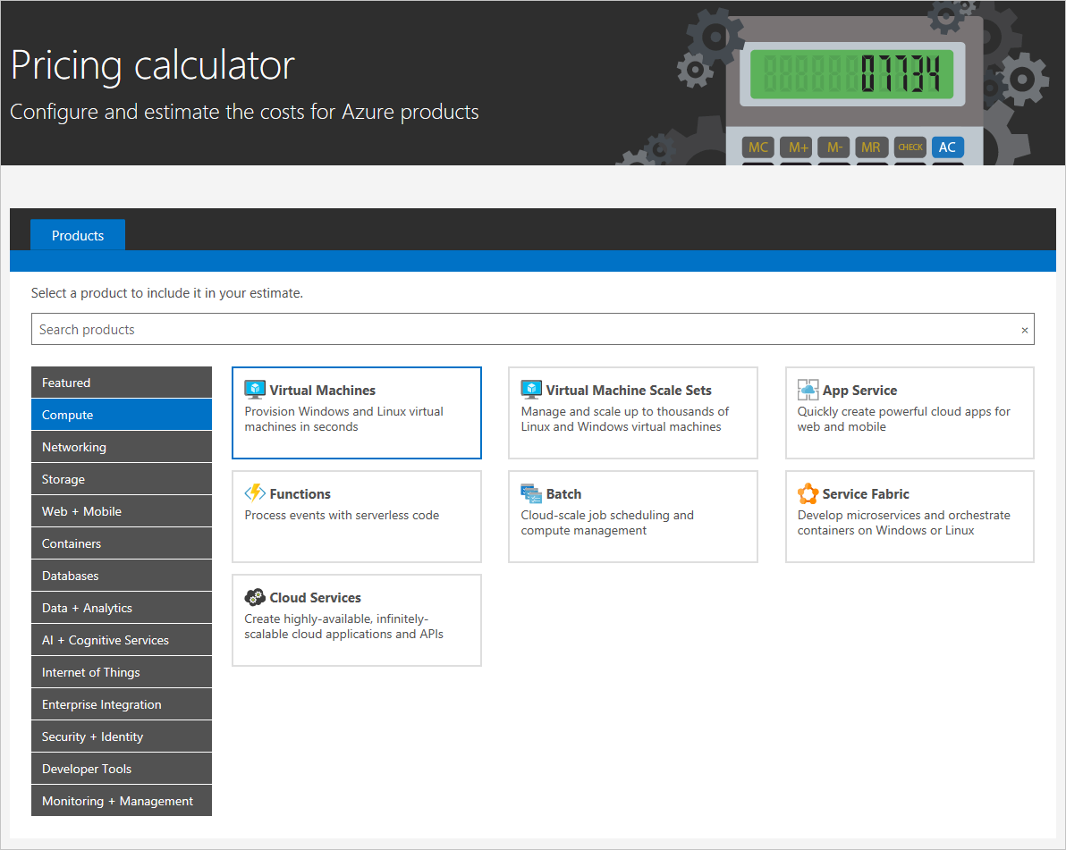
Estimating Costs
Calculate estimates with Azure Price Calculator:
https://azure.microsoft.com/en-us/pricing/calculator/

Slide 140
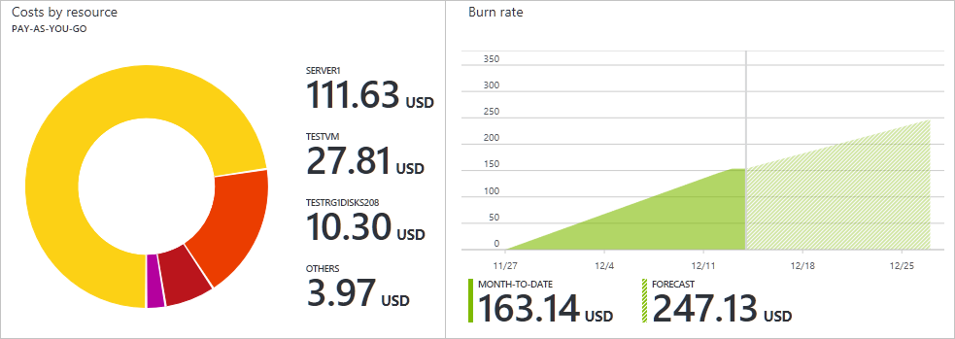
Monitoring Costs
Use resource tags!
Regularly monitor current and projected costs on dashboard

Slide 141
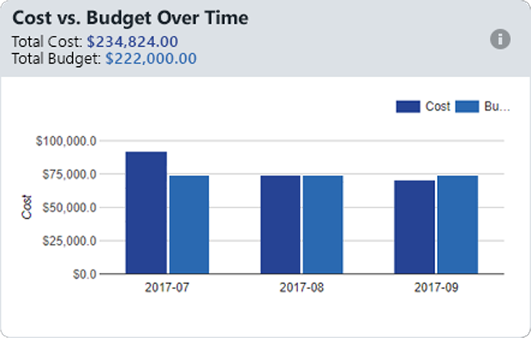
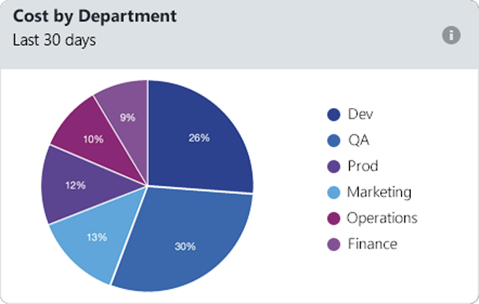
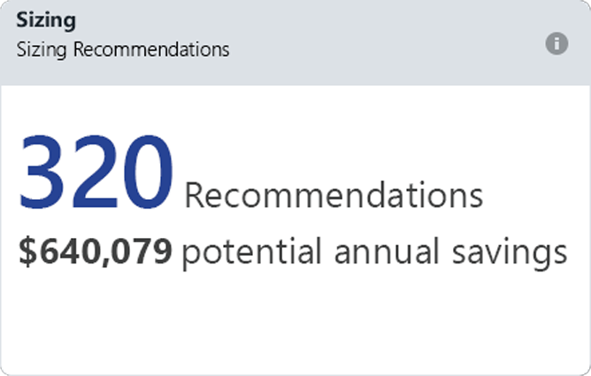
Azure Cost Management
Monitor cloud spend
Drive organizational accountability
Optimize cloud efficiency

Slide 142
Ways to save on costs

Slide 143
Cost savings
VMs:
Use burstable B-Series VMs
Take advantage of reserved pricing
Use preemptible compute
Use Auto-Shutdown
STOP the VM, not just shut down

Slide 144
Cost savings
Use autoscaling to scale DOWN
Scale down based on known schedules
Utilize cloud storage as much as possible
Blob storage is extremely cheap in the cloud
Archive data, move infrequently accessed data
Utilize cold storage
Use containers to maximum application density
Turn on and use Azure Advisor
Use Azure DevTest Labs for non-prod environments
Notes:
People talk about scaling up as being the power of the cloud (infinite scalability!)
NO! The power is scaling down. You didn’t buy the hardware, you’re only rending it

Slide 145
Example

Slide 146
The problem to solve:
Files get uploaded throughout the day and need to be processed
Need to transform the data and output to a new directory
In this case, file contains a number and the output file contains the numbers factors
Scenario

Slide 147
Azure VM with Windows Service
Similar to on-prem approach
Host a VM, store files in directory, use a service to watch the directory, process, and output to another directory
Option 1

Slide 148
Variable pricing based on VMs
Redundancy would be required
Cheaper options:
A0 Instance = 1 Core, 0.75 GB RAM, 20 GB Storage = $14.88 / month
A1 Instance = 1 Core, 1.75 GB RAM, 70 GB Storage = $66.96 / month
D1 Instance = 1 Core, 3.5 GB RAM, 50 GB Storage = $104.16 / month
D2 Instance = 2 Cores, 7 GB RAM, 100 GB Storage = $208.32 / month
Option 1

Slide 149
Given
1 minute to process every file
Function uses 128 MB of memory when processing
Result: 53,333 executions per month are free
Can process ~1,709 files a day at no cost for a 31 day month
Option 2

Slide 150
How much does it cost if you go over?
Given same processing time and memory usage
2,000 files / day = 62,000 executions = $1.04 / month
3,000 files / day = 93,000 executions = $4.76 / month
5,000 files / day = 155,000 executions = $12.20 / month
10,000 files / day = 310,000 executions = $30.80 / month
Option 2

Slide 151
Pros of using Azure Functions in this case
Azure functions scale horizontally and run in parallel automatically, so files are processed as they come in and not sequentially
Only need to write the code to process one file, and not the code to manage processing in parallel
Low cost and no server management or maintenance
Comparison

Slide 152
Drawbacks of Azure Functions
Limited to 10 minutes per execution
Less CPU resources on Azure’s Consumption Plan, so processing an individual file could take longer than a standard VM
Can be increased using an App Service Plan, but subject to standard App Service Plan rates
Comparison

Slide 153
Warning! New Dangers!

Slide 154
Dangers
Serverless cost runaway
One bad line of code can have direct $$$ consequences
Mitigating this requires an App Service Plan, which defeats the purpose of making it serverless
New type of attack: Cost attacks
Steal compute cycles to make money (e.g. Bitcoin mining)
Maliciously run up your bill by saturating expensive operations
Rate limiting is a REQUIREMENT when going serverless

Slide 155
Conclusion

Slide 156
What we covered today
Azure Data Storage
App Service Plans
Container Architecture
Serverless Architecture
Networking
Messaging
Management and Security
Azure APIs and Services

Slide 157
Takeaways
Lots of services | Data, Compute, APIs, etc...
More Than One Way
Easy to Start, Hard to Master

Slide 158
Where to Learn More
Azure Resources
Azure Docs: https://docs.microsoft.com/en-us/azure/
Cloud Patterns: https://docs.microsoft.com/en-us/azure/architecture/patterns/
Free Pluralsight Courses: https://www.pluralsight.com/partners/microsoft/azure
CUNA Resources
Titan Team Repo/Wiki: https://cunamutual.visualstudio.com/SecureCloudEnablement
Azure Cloud MS Teams Site

